Slide 1
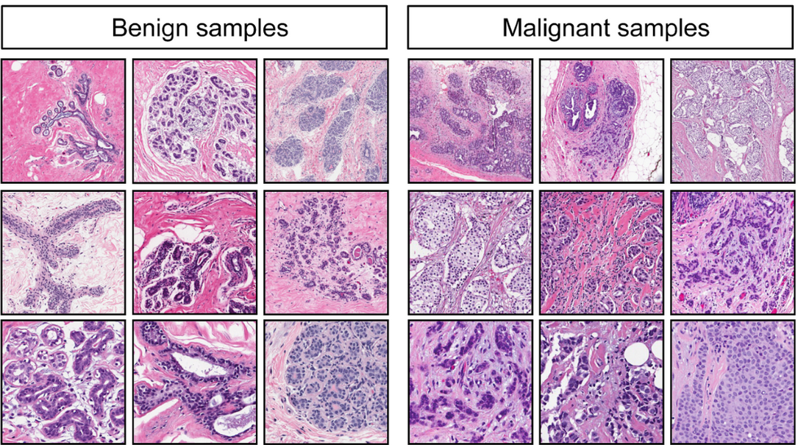
MACHINE LEARNING 2 PROJECT ON BREAST CANCER WISCONSIN (DIAGNOSTIC) DATA SET
BY
Devender Kumar

Slide 2
Topics
Overview of Dataset
Exploratory Data Analysis
Dummy features(one-hot encoding)
KNN for Classification
Applying PCA on data set
KNN using PCA
Plotting ROC curve
Model Selection

Slide 3
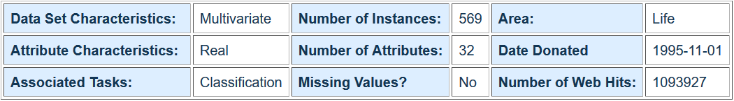
Overview of Dataset
The data set features are computed from a digitized image of a fine needle aspirate (FNA) of a breast mass. They describe characteristics of the cell nuclei present in the image. The dataset was created from digitized images of healthy (benign) and cancerous (malignant) tissues.
Here we are going to predict the results for benign and malignant tissues by using the best suit Machine Learning Algorithm.
Dataset:
https://github.com/DevenderKumar090/ML2-PCA-Project/blob/master/cancer.csv

Slide 4
Overview of Dataset
Attribute Information:
Target Variable :
Diagnosis (M = malignant, B = benign)
Explanatory Variables:
ID number
Ten real-valued features are computed for each cell nucleus: a) radius (mean of distances from center to points on the perimeter) b) texture (standard deviation of gray-scale values) c) perimeter d) area e) smoothness (local variation in radius lengths) f) compactness (perimeter^2 / area - 1.0) g) concavity (severity of concave portions of the contour) h) concave points (number of concave portions of the contour) I) symmetry j) fractal dimension ("coastline approximation" - 1)

Slide 5
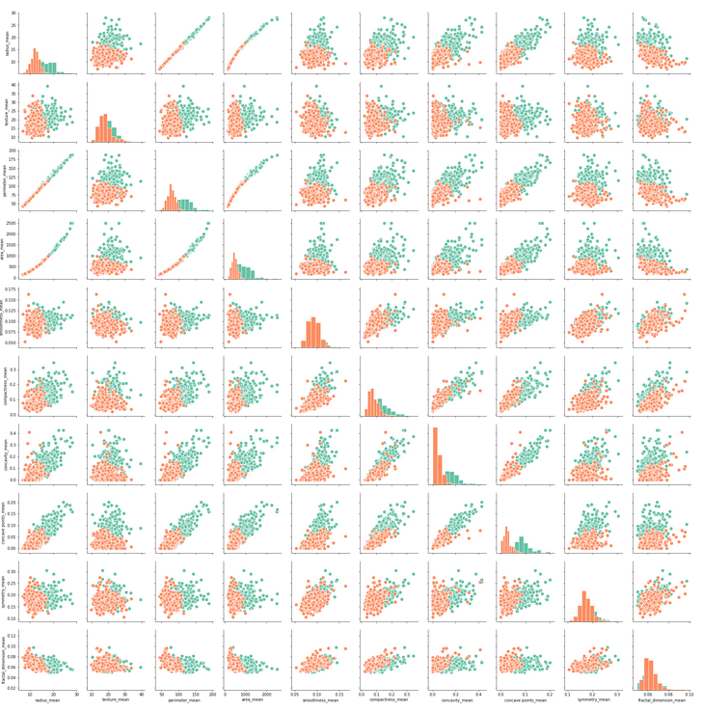
Exploratory Data Analysis
Scatter plot with hue as diagnosis (M(orange)/B(green) verses to the Explanatory Variables:

Slide 6
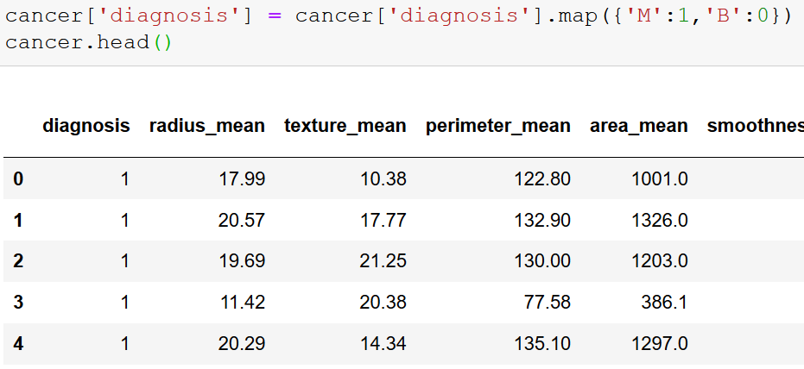
Dummy Features( one- Hot Encoding)
We perform One –Hot encoding on columns to make it either to 0 or 1 into a binary format .Like wise we applied for diagnosis column.

Slide 7

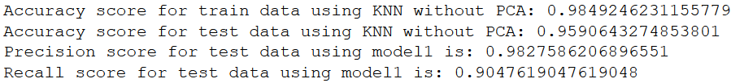
KNN for Classification
KNN is a non-parametric, lazy learning algorithm. Its purpose is to use a database in which the data points are separated into several classes to predict the classification of a new sample point with help to nearest neighbors.
After Finding the Result is as below:
Confusion Matrix:
This model gave less True/False negatives and best accuracy, precision and recall score compared to others.so choosed KNN.

Slide 8
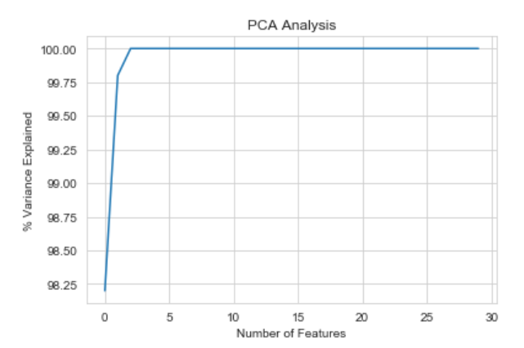
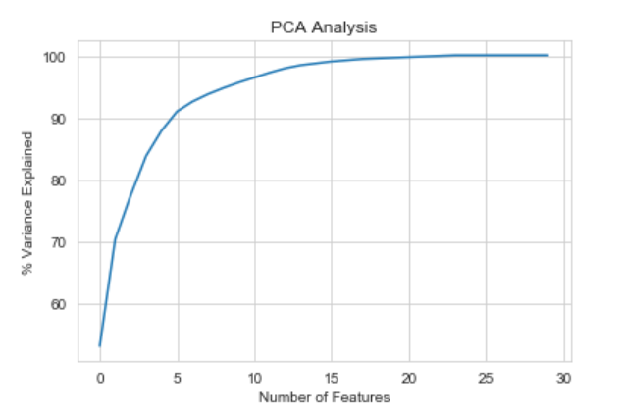
Applying PCA on data set
The main idea of principal component analysis (PCA) is to reduce the dimensionality of a data set consisting of many variables correlated with each other, either heavily or lightly, while retaining the variation present in the dataset, up to the maximum extent.
Importantly, the dataset on which PCA technique is to be used must be scaled. The results are also sensitive to the relative scaling.
Normal X Scaled X using Min Max Scaler

Slide 9
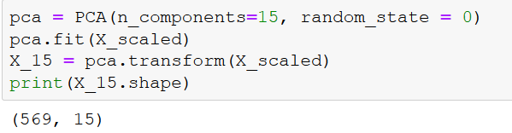
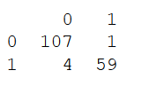
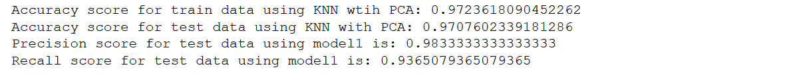

KNN using PCA
Used transformed X for train/test splits for better results
Confusion Matrix:

Slide 10
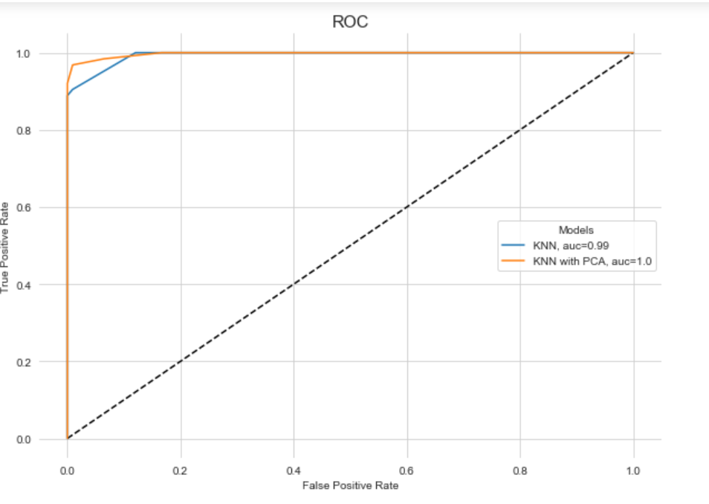
Plotting ROC Curve
Receiver Operating Characteristic (ROC) curve is a plot of the true positive rate against the false positive rate. The AUC is the Area Under Curve. If the AUC is high, the model is better distinguishing between positive and negative class.

Slide 11
Model Selection
The highest AUC is obtained for the KNN with PCA model, with a round off value of 1. This means there is 99%(without round off) chance that the model will be able to distinguish between malignant and benign.
KNN with PCA also has best test accuracy and recall score compare to normal KNN .so we select this Model.
Reference:
https://github.com/DevenderKumar090/ML2-PCA-Project/blob/master/cancer.csv

Slide 12
Thank You

